Slide 1

Rajshahi University of Engineering & Technology
Department of Mechatronics Engineering
Advance IoT Based Remote Patient Health Monitoring System
Course: MTE 3104 - Microcontroller and Interfacing Sessional
Submitted By: | Submitted To:
ABRAR FAIYAZ ANAN CHOWDHURY ID: 2008008 MAMUN OR RASHID ID: 2008025 AL NIMRA KABIR ID: 2008042 MOSTOFA SHAKIL RAFI ID: 2008044 MD.MEHERAZUL KARIM ID: 2008046 SAROWER HOSEN TANIM ID: 2008047 | MD. SAKIB HASSAN CHOWDHURY Lecturer Department of Mechatronics Engineering Rajshahi University of Engineering & Technology

Slide 2

Rahim Mia
Age: 76 Profession: Farmer
Address: Langalbandh, Shailkupa, Jhenaidah

Slide 3
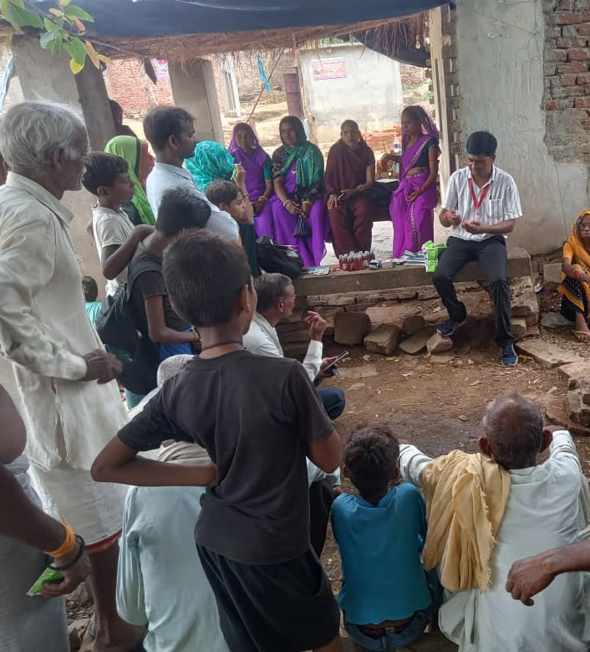
WHAT IS BROKEN?
According to the Bangladesh Bureau of Statistics,
Deaths In Rural Bangladesh that Could Be Addressed
Without Timely Healthcare Monitoring
60%
Ministry of Health
report reveals
Delays in Receiving Critical
Health Information
Lack Access To Quality
Healthcare Monitoring
70%
40%
WHY IS IT BROKEN?
Limited Facilities
Skilled personnel & Internet hinder Monitoring
Limited Access
Healthcare Infrastructure & Monitoring Devices
Advance IoT Based Remote Patient Health Monitoring System

Slide 4



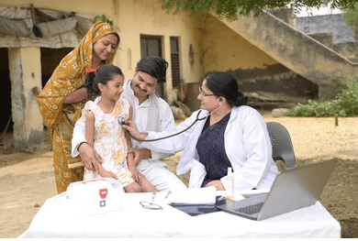
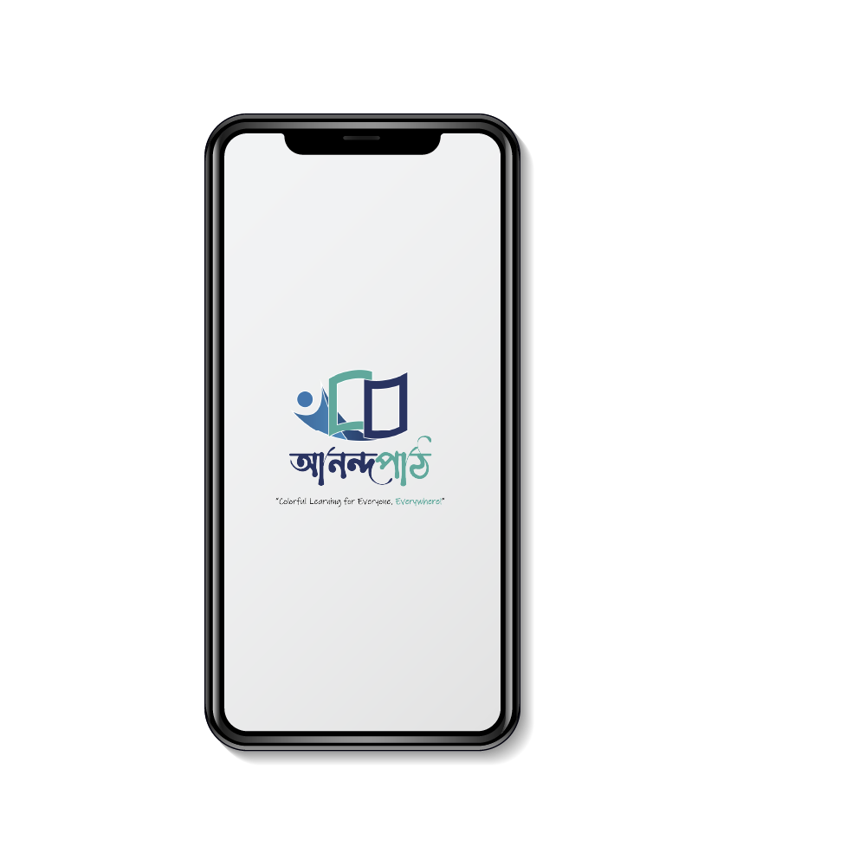
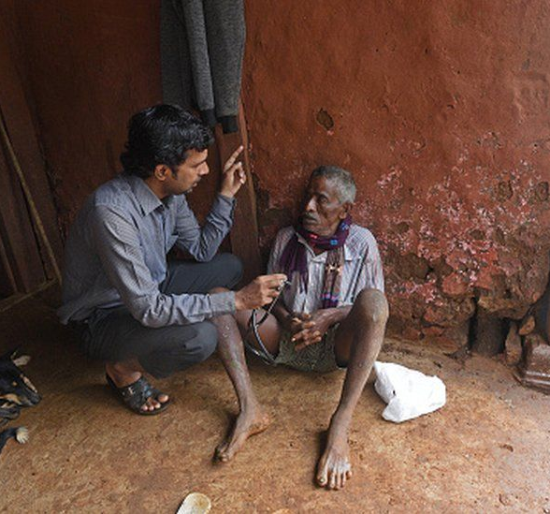
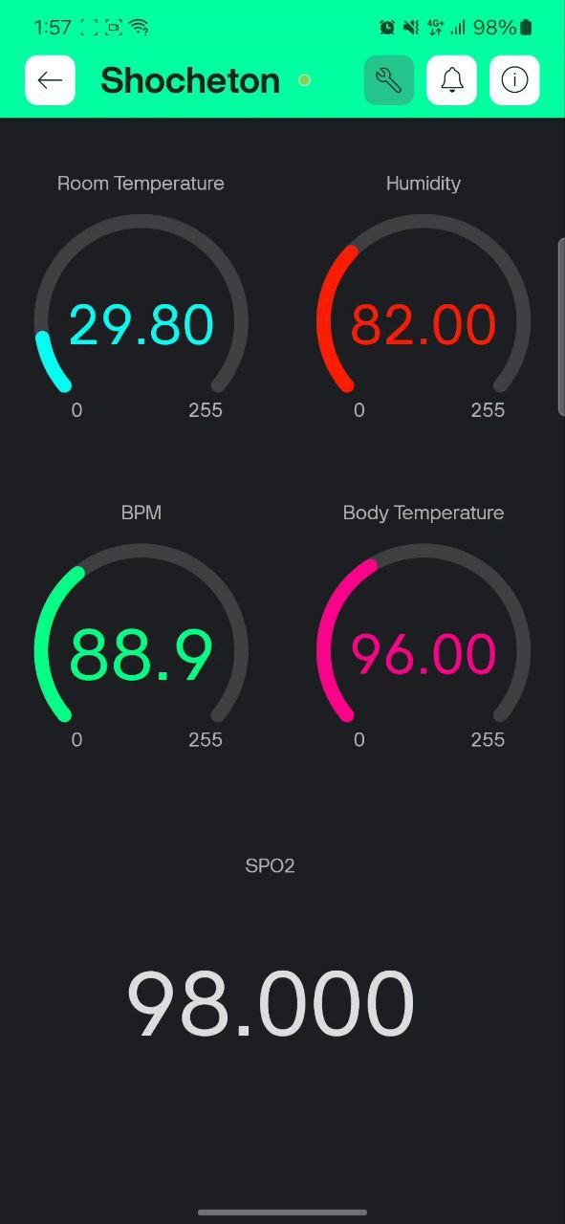
SOLUTION
SDG Alignment
Bridging the Healthcare Gap
Real-Time Data & Insights
Improved Healthcare Outcomes
Wireless Patient Monitoring System
Healthcare Challenges

Slide 5
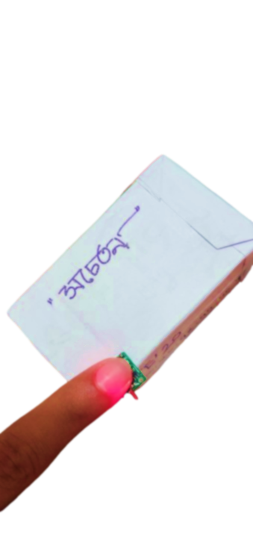
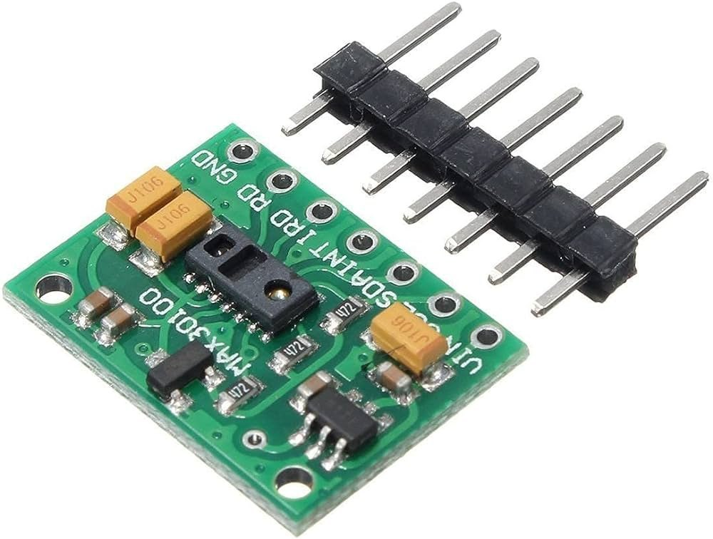
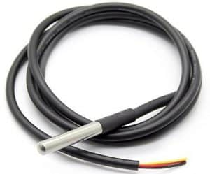
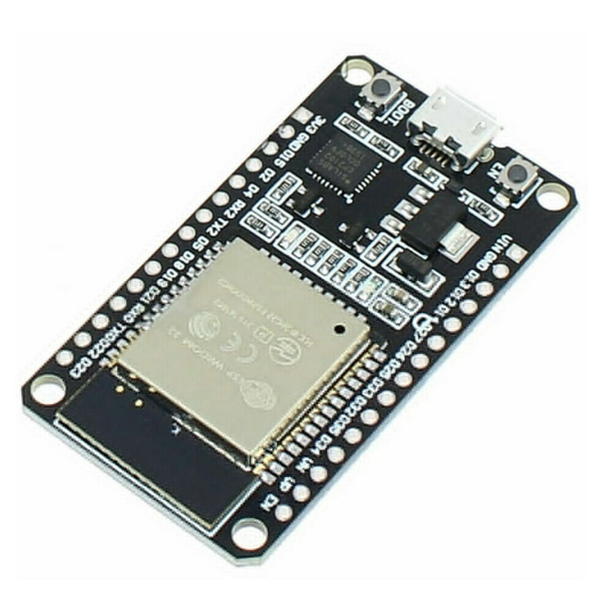
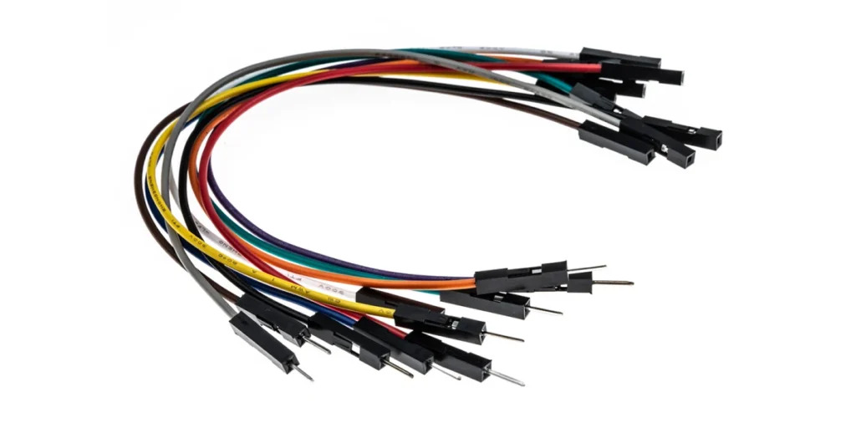
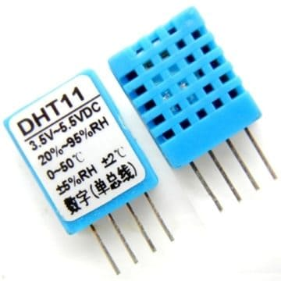
PROJECT IDEA
A wireless patient health monitoring system through mobile app - “সচেতন”
MAX30100 Pulse
Oximeter Sensor
DS18B20
Temperature Sensor
Connecting Wires
ESP32
সচেতন
DHT11
Humidity Sensor

Slide 6
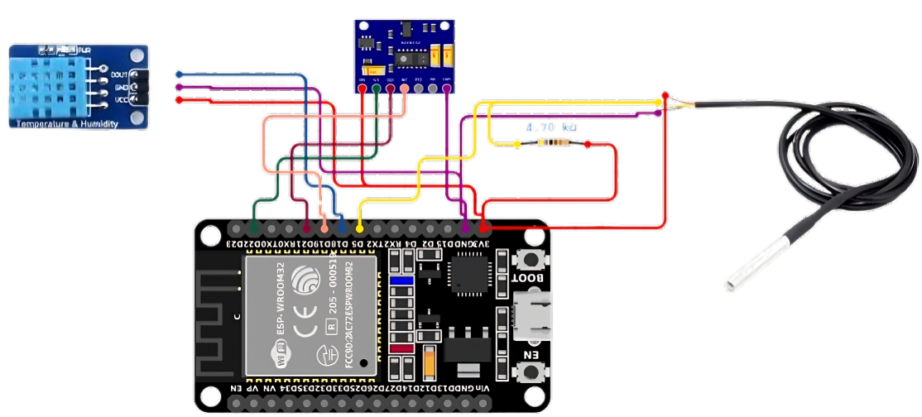
CIRCUIT DIAGRAM
MAX30100 Pulse
Oximeter Sensor
DHT11
Humidity Sensor
DS18B20
Temperature Sensor
Circuit Diagram
Code Link
ESP32

Slide 7
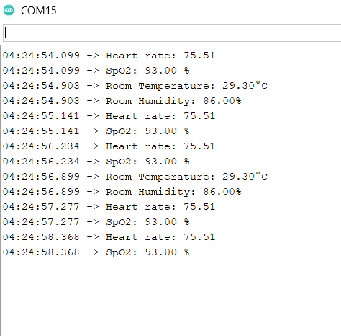
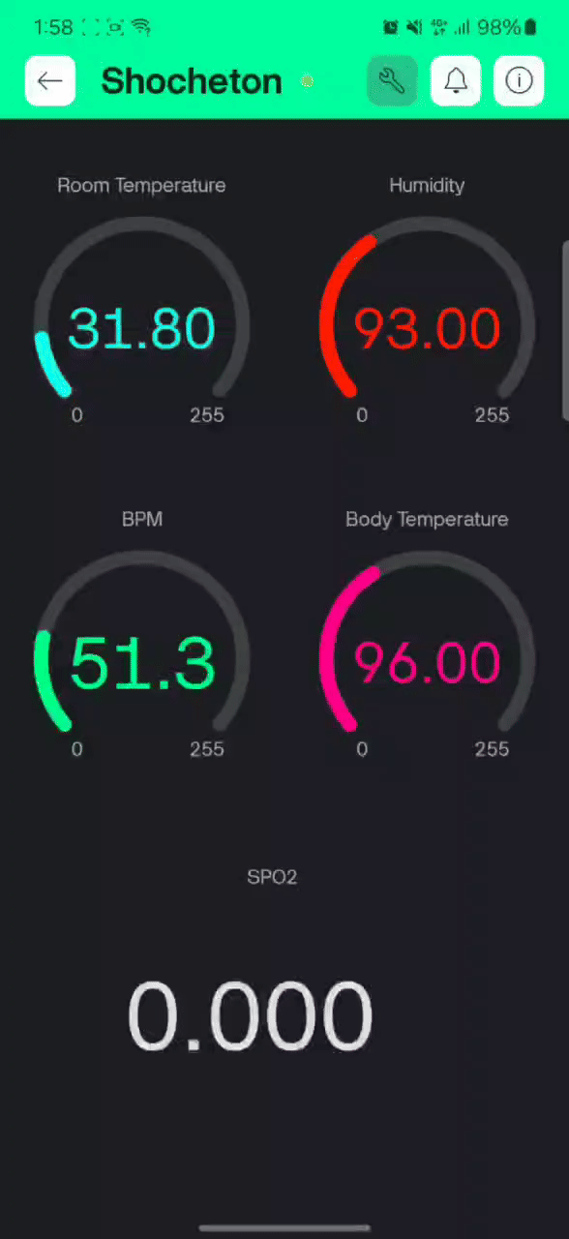

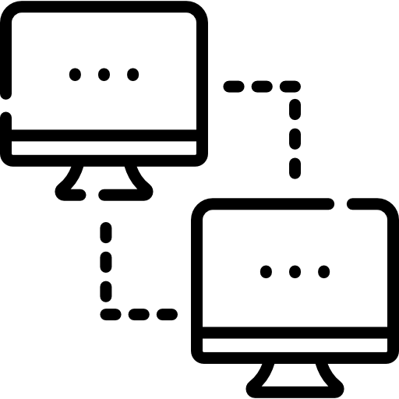
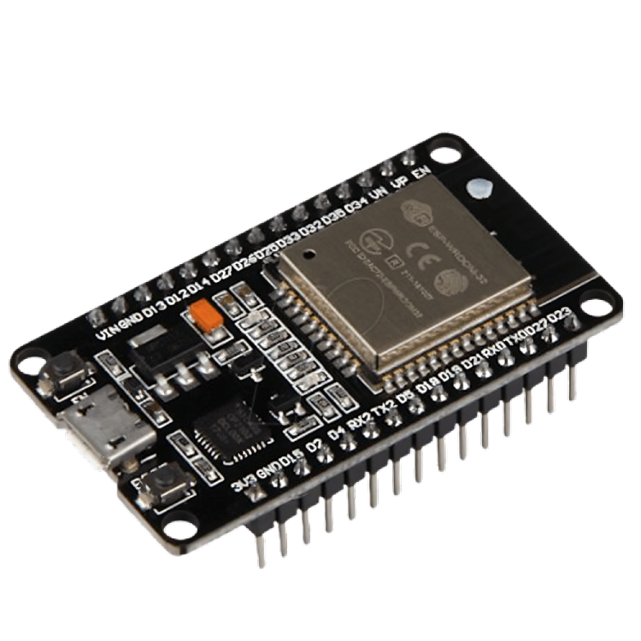
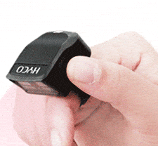
How “সচেতন” Works
Wireless Data Transfer to a Mobile App Outside the local Network
Wireless Data Transfer which is in Local Network
Detected Pulse &
SP0₂ Level
MAX30100 Pulse
Oximeter Sensor
Detected Body
Temperature
DHT11
Humidity Sensor
DS18B20
Temperature Sensor
ESP32
Fingertip
Detected Room Humidity &
Room Temperature

Slide 8
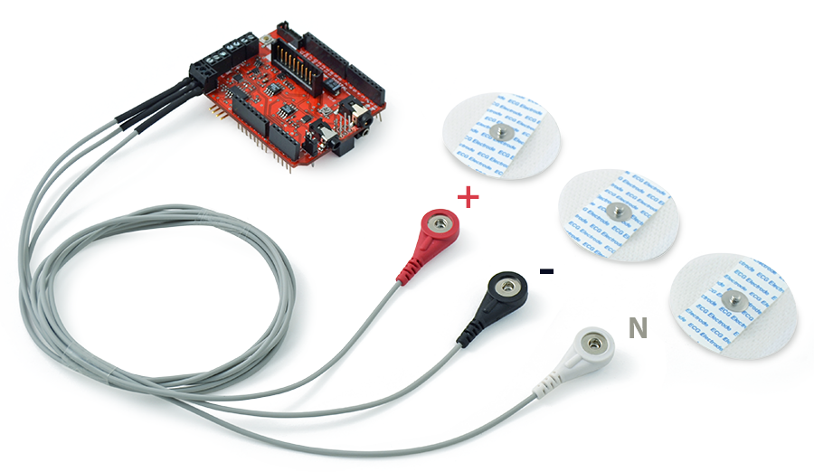
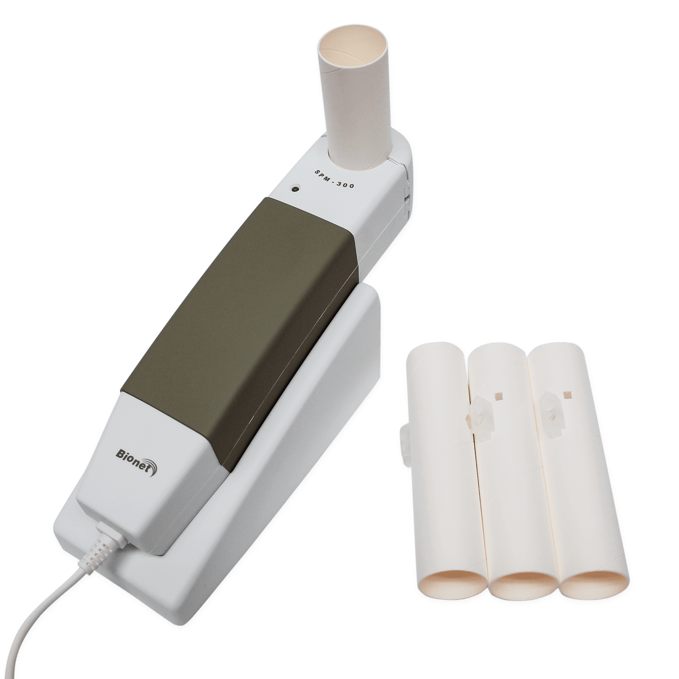
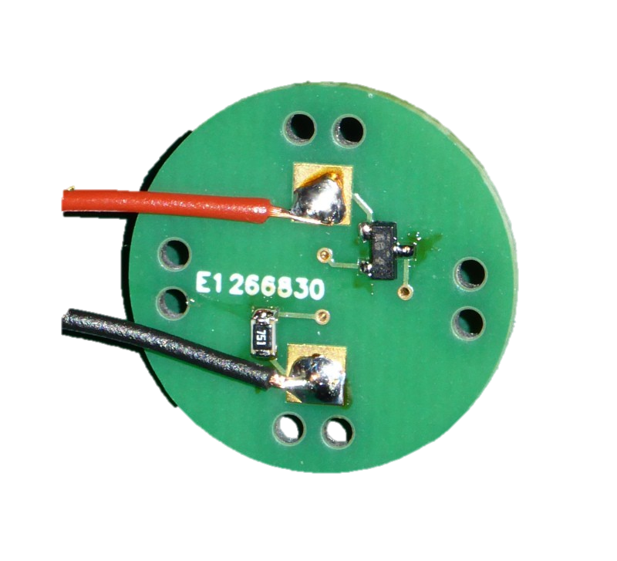
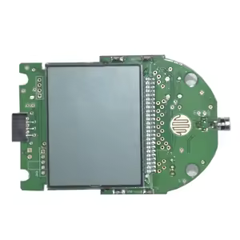
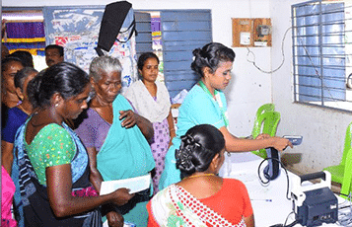
FUTURE OPPORTUNITIES
1
ECG, Glucose, & Spirometer
sensors
ECG Sensor
In Future
2
Electrolyte Imbalance
Sensors
Spirometer Sensor
Electrolyte Imbalance Sensor
3
Telemedicine Camps in remote villages
Glucose Sensor
Telemedicine Camps in village schools

Slide 9

Let’s Connect the Healthcare Solution with just a fingertip.
THANK YOU
Advance IoT Based Remote Patient Health Monitoring System

Slide 10
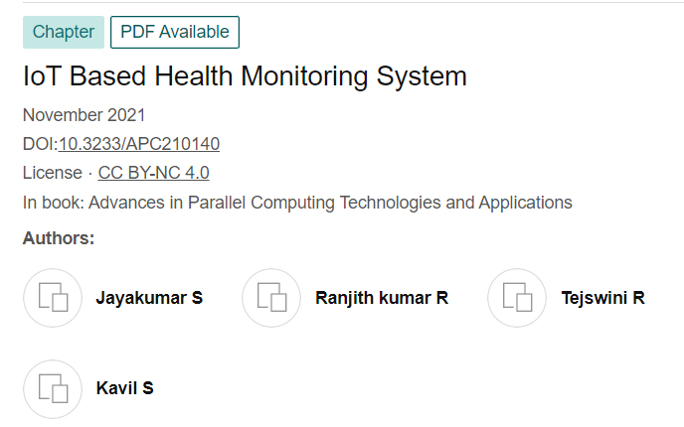
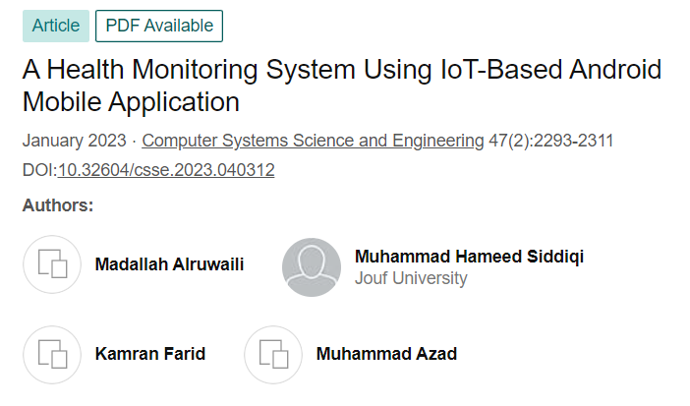
APPENDIX
PROOF OF CONCEPT
Component List
1
S.N. | Components Name | Quantity | Price
1 | ESP32 Board | 1 | 480 Tk
2 | MAX30100 Pulse Oximeter Sensor | 1 | 350 Tk
3 | DS18B20 Sensor | 1 | 150 Tk
4 | DHT11 Sensor | 1 | 200 Tk
5 | Resistor 4.7K | 1 | 5 TK
6 | Connecting Wires | 10 | 50 Tk
7 | Breadboard | 1 | 70 Tk
 |  | Total: | 1305 Tk
2
3
Admin (2023) IOT based patient health monitoring on ESP32 web server, How To Electronics. Available at: https://how2electronics.com/iot-based-patient-health-monitoring-esp32-web-server/ (Accessed: 18 October 2024).

